Slide 1
Estimation
By Dr. Justin Bateh, Florida State College at Jacksonville &
Dr. Bert Wachsmuth, Seton Hall University

Slide 2
The Normal Distribution and its Relatives
We will now switch gears and start involving probabilities in our next discussions. This course is a course in Statistics, and not in Probability Theory, however, so we will only use as much probability as necessary to discuss statistical concepts, and we will not study probability theory in it's own right here. We will also, for the most part, restrict our attention to numerical variables only from now on.
First, let's briefly introduce the concept of probability and see how it relates to our previous work.
Probability: We will consider a "probability of an event" as the chance, or likelihood that an event indeed takes place. All probabilities will be numbers between 0.0 and 1.0, where a probability of 0 means that an event does not happen and a probability of 1.0 means that an event will happen for certain. We will often use the notation P(A) to denote the "probability of A". The total probability of all events must add up to 1.0.

Slide 3
Example: What is the probability in tossing one (fair) coin that it shows Heads. What is the probability in getting a number 5 or larger when throwing one die? What is the probability of two dice adding to 4 when tossing them simultaneously?
In many cases probabilities can be obtained by counting. In tossing a coin, for example, there are two possible outcomes, head and tail, and both are equally likely (if the coin is fair). Thus, the probability of obtaining a head outcome should be 1 out of 2, or 1/2, which in math simply means "1 divided by 2". Thus:
P(one Head) = 0.5
Similarly, for a die there are 6 possible outcomes, all equally likely. Thus, the event of obtaining a number 5 or more is comprised of the event of getting a 5 or a 6. Thus, the corresponding probability should be 2 out of 6, or 2/6, or 1/3.
P(5 or 6) = 1/3 = 0.3333

Slide 4
Finally, if we through two dice simultaneously, each could show a number from 1 to 6. To illustrate what happens, we create a table where each entry inside the table denotes the sum of the two dices:
But now it's again an exercise in counting: there are a total of 36 possible outcome. We are interested in the sum of the dice being 4, and from the table we see that there are 3 possible throws adding up to 4 (a 3+1, 2+2, and 1+3). Thus, our probability is 3 out of 36, or 3/36, which reduces to 1/12. Thus:
P(sum of two dices = 4) = 1/12 = 0.0833
 | 1 | 2 | 3 | 4 | 5 | 6
1 | 2 | 3 | 4 | 5 | 6 | 7
2 | 3 | 4 | 5 | 6 | 7 | 8
3 | 4 | 5 | 6 | 7 | 8 | 9
4 | 5 | 6 | 7 | 8 | 9 | 10
5 | 6 | 7 | 8 | 9 | 10 | 11
6 | 7 | 8 | 9 | 10 | 11 | 12

Slide 5
    Sample exercises: to see if you can compute probabilities by counting, find (a) the probability of obtaining at least one tail when tossing one coin twice, (c) the probability of getting a Queen when randomly drawing one card from a standard deck of 52 cards, and (c) the probability of the sum being at most 10 when throwing two dice.
In more real-life experiments it may be too time consuming, or simply not possible, to list all possible outcomes to count out the ones we are interested in, but we can instead use a frequency histogram to come up with approximate probabilities. For example, suppose that a (hypothetical) frequency distribution for the age of people in a survey is as follows:
Category | Probability
0 – 18 | 0.15
19-40 | 0.25
41-65
65 and older | 0.3

Slide 6
Here we simply used decimal numbers instead of percentages, i.e. the entry in the first row means that 15% of the people in the survey were between 0 and 18 years old.
One number is missing in the table above – what is that number?
  We know that probabilities have to add up to 1.0, so the missing number is 1.0 - (0.15 + 0.25 + 0.3) = 0.3. This works if one number is missing, but as soon as two numbers were missing this trick would no longer work.
What is the chance that a randomly selected person is 40 years or younger?
  The event of being 40 years or younger means that a person is either in the 0 to 18 category, with probability 0.15, or in the 19 to 40 category, with probability 0.25. Therefore, the total probability or a person being younger than 40 is 0.15 + 0.25 = 0.40, or equivalently 40%.

Slide 7
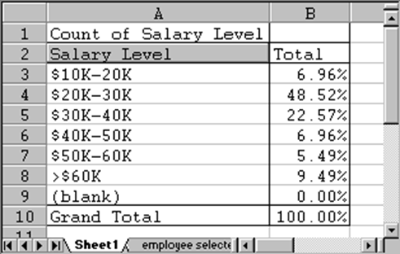
Example: In section 5.2 we discussed a survey that asked 474 randomly selected people for their income level. If we were to meet one of these employees at random, what is the probability that this person has an annual income between $30,000 and $40,000?
If we followed the above example of coins and dice, we could simply count how many employees of the 474 participants earn between $30K and $40K. That number, out of 474, would be our desired probability. However, in section 5.2 we have already created frequency charts using percentages, and that chart can directly give us the answer. In our case, recall that the chart we created was:
From the chart we see that 22.57% of the people questioned earn between $30K and $40K, thus
P(annual salary between $30K and $40K) = 0.2557

Slide 8
In addition to a percentage chart it is often helpful to consider probabilities in relation to frequency histograms graphically.
Example: Consider the Excel Data set health_female.xls, showing a number of variables related to the health records of 40 female patients, randomly selected. Construct a frequency histogram for the height of the 40 patients, including a chart. Then use that histogram to find the following probabilities. For each question, shade the part of the histogram chart that you used to answer the question.
  What is the probability, approximately, that a woman is 60 inches or
  What is the probability, approximately, that a woman is 65 inches or
  What is the probability, approximately, that a woman is between 60 and 65 inches tall?

Slide 9
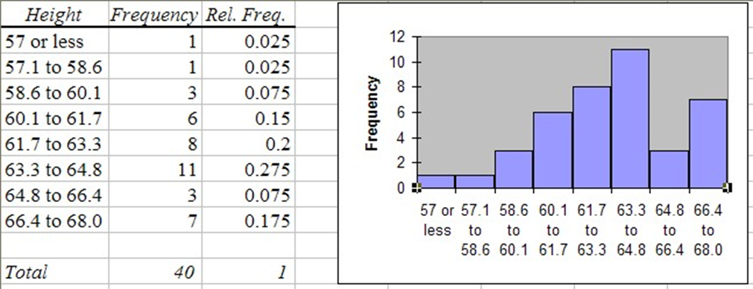
We first download the data set, as usual, and construct a frequency histogram (as discussed in section 3.4). We have chosen the specific bin boundaries as show in the picture, and we have modified the histogram table slightly to clarify the bin boundaries. We also computed the relative frequency for each row, defined as the number in that row divided by the total number of observations. The resulting table and chart look as follows:

Slide 10
From this chart it is now easy to answer the questions. Note that our bin boundaries do not exactly correspond to the boundaries posed in the questions, but we can use the closest bin boundary available to get the approximately right answer.
  P(a woman is 60 inches or smaller) = (1 + 1 + 3) / 40 = 5 / 40 = (0.025 + 0.025 + 0.075) = 0.125 (or 12.5%)
  P(a woman is 65 inches or taller) = (3 + 7) / 40 = (0.075 + 0.175) = 0.25 (or 25.0 %)
  P(a woman is between 60 and 65 inches tall) = (6 + 8 + 11) / 40 = 25 / 40 = (0.15 + 0.2 + 0.275) = 0.625 (or 62.5%)

Slide 11
Graphically speaking (I know, you can't speak graphically -:) we have used the parts of the histogram shaded in red to compute the respective probabilities:
To make sure, our probabilities are approximate because the bin boundaries don't exactly match the questions. In addition, we have not really computed, for example, that the probability of "a woman" to be between 60 and 65 inches tall is 62.5%. Strictly speaking we have computed that the probability of a randomly selected woman out of our sample of 40 woman is between 60 and 65 inches tall is 62.5%.

Slide 12
But if in turn the entire sample was truly randomly selected, then it is a fair guess to say that:
  the probability of any woman to be between 60 and 65 inches tall is 62.5%
where we have generalized from the woman in our sample to the set of all woman. It should be clear that the 62.5% answer is correct if all we consider is our 40 woman in the sample. It should be equally clear that this 62.5% is only approximately correct if we generalize to all woman.
In the next section we will clarify what we mean by approximately correct and we will introduce formulas to compute the error involved in this type of generalization. But before we can do that, we must discuss the concept of a Normal Distribution.

Slide 13
The Normal Distribution
If you compute a lot of frequency histograms and their associated charts you might notice that most of them differ in detail but have somewhat similar shapes: the chart is "small" on the left and right side, with a "bump" in the middle. With a little bit of imagination you might say that many distributions look somewhat similar to a "church bell". Here are a few histogram charts, with the imagined "church bell" super-imposed (all of the data comes from the health_female.xls data file and a similarhealth_male.xls data file):

Slide 14
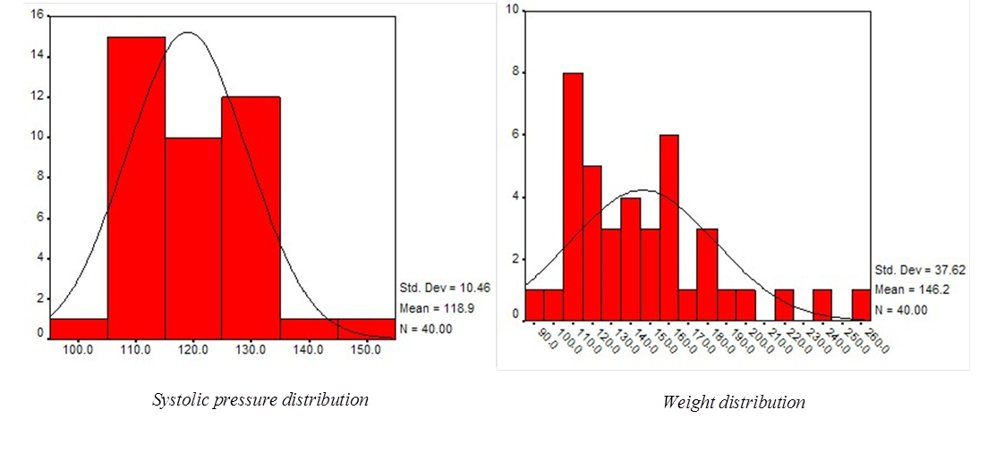
These bell-shaped distributions differ from each other by the location of their hump and the width of bell's opening, and they have a special name:
  Normal Distribution: A distribution that looks bell-shaped is called a normal distribution. The position of the hump is denoted by m and stands for the mean of the distribution, and the width is denoted by s and corresponds to the standard deviation. Thus, a particular normal distribution with mean m and standard deviation s is denoted by N(m, s). The special distribution N(0, 1) is called the standard Normal distribution.

Slide 15
We can now use these normal distributions to help us compute probabilities.

Slide 16
Using Normal Distributions to Compute Probabilities with Excel
Instead of creating a frequency histogram with (more or less) arbitrary bin boundaries, compute the mean and the standard deviation of the data. Then use the normal distribution with that particular mean and standard deviation to compute the probabilities you are interested in.
Example: Before we considered the Excel Data set health_female.xls, showing a number of variables related to the health records of 40 female patients, randomly selected. Compute the mean and standard distribution for the height variable of that data set, then use the corresponding normal distribution to compute the probabilities below. For each question, shade the part of the normal distribution that you use to answer the question.
  What is the probability, approximately, that a woman is 60 inches or smaller?
  What is the probability, approximately, that a woman is 65 inches or taller?
  What is the probability, approximately, that a woman is between 60 and 65 inches tall?
As explained in chapter 4, we can use Excel to quickly compute the mean and standard deviation to be:
mean = 63.2, standard deviation = 2.74

Slide 17
The corresponding normal distribution and the areas we have to figure out are pictured as follows:

Slide 18
The good news is that Excel can easily compute these areas under a Normal Distribution. The bad news is that it is not completely straight-forward. Excel provides the formula:
NORMDIST(x, m, s, true)
where m and s are the mean and standard deviation, respectively, and the last parameter, at least for our purposes should be set to true. The value of that formula represents always the probability (aka area under the curve) from the left side under the normal distribution up to the value of x.
For example:

Slide 19
Note that the last value happens to be exactly the area we need to answer the first of our questions. Therefore:
P(x <= 60) = 0.1214
while the original method, using the actual frequency histogram, yields 0.125. Both computed values are close to each other, but using the Normal distribution is faster and allows for arbitrary boundary points to be used.
Other probabilities can be computed in a similar way, using the additional fact that the probability of everything must be 1. For example, suppose we want to use a N(63.2, 2.74) normal distribution to compute the probability P(height >= 65). If we simply used the Excel formula
NORMDIST(65, 63.2, 2.74)
then we would compute P(height <= 65), which is not what we want (in fact, it is kind of the opposite of what we want). However, it is clear that:
P(height <= 65) + P(height >= 65) = 1
because one of those two events must happen for sure. Therefore:
P(height >= 65) = 1 - P(height <= 65)

Slide 20
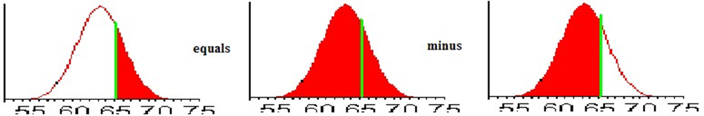
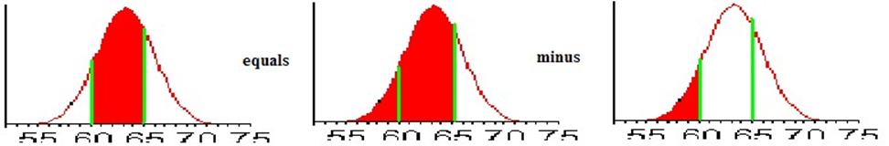
or shown as a picture
because of the way the NORMDIST Excel function is defined. To compute a probability like P(60 <= height <= 65), we can apply a similar trick:
P(60 <= height <= 65) = P(height <= 65) - P(height <= 60)
or shown as a picture

Slide 21
But now the important thing is to realize that in the right side the probabilities are computed for shaded areas that start on the left side of the distribution and go up to a specific value. That is exactly what the Excel formula NORMDIST computes, so we can now - finally - compute the probabilities in our question, using Excel:
Please note that there is a very close match between these probabilities and the probabilities computed using the actual frequency histogram.

Slide 22
Now, in fact, we can use Excel to rapidly compute probabilities without ever constructing a frequency histogram at all. In fact, we don't even need to have access to the complete data set, all we need is to know the mean and the standard deviation of my data so we can pick the right normal distribution to compute the probabilities.
Example: Consider the Excel Data set health_male.xls, showing a number of variables related to the health records of 40 male patients, randomly selected. Without constructing a frequency histogram for the height of the 40 patients, find the following probabilities:
  What is the probability, approximately, that a man is 60 inches or smaller?
  What is the probability, approximately, that a man is 65 inches or taller?
  What is the probability, approximately, that a man is between 60 and 65 inches tall?

Slide 23
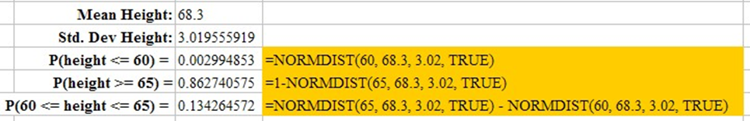
Instead of constructing a complete frequency histogram, we quickly use Excel to compute the mean and the standard deviation of our data. Then we use the NORMDIST function, just as above, but of course using the mean and standard deviation for this data set, not the one we previously used. Here is a look at the Excel spreadsheet that shows the answer.
Note that the probability of a man being less than 60 inches tall is now about 0.003, or 0.3%, much lower than the probability for a woman. That makes sense, since men are, on average, taller than woman (68.3 inches versus 63.2 inches) so the probability of a man being less than 60 inches tall should indeed be lower than the comparable probability for women. The other figures equally make sense.
The computed probabilities will be (approximately) correct under the assumption that the height of men is indeed normally distributed, approximately.
Now it should be clear how to use the various normal distribution to quickly compute probabilities. To practice, here are a few exercises for you to do. The answers are listed, but not how to get them. Remember, you often cannot use NORMDIST directly, you sometimes need to use 1 - NORMDIST or subtract two NORMDIST values from each other to get the correct answer.

Slide 24
Example: Find the indicated probabilities, assuming that the variable x has a distribution with the given mean and standard deviation.
  x has mean 2.0 and standard deviation 1.0. Find P(x <= 3.0)
  x has mean 1.0 and standard deviation 2.0. Find P(x >= 1.5)
  x has mean -10 and standard deviation 5.0. Find P(-12 <= x <= -7)
  x is a standard normal variable. Find P(x <= -0.5)
  x is a standard normal variable. Find P(x >= -0.5)
  x is a standard normal variable. Find P(x >= 0.6)
  x is a standard normal variable. Find P(-0.3 <= x <= 0.4)
Answers:
  P(x <= 3.0) = 0.841344746
  P(x >= 1.5) = 0.401293674
  P(-12 <= x <= -7) = 0.381168624
  P(x <= -0.5) = 0.308537539
  P(x >= -0.5) = 0.691462461
  P(x >= 0.6) = 0.274253118
  P(-0.3 <= x <= 0.4) = 0.273333164

Slide 25
The Central Limit Theorem
In the previous section we first saw that we can use frequency distributions to compute probabilities of various events. Then we saw that we could use various normal distributions as a shortcut to compute those probabilities, which was very convenient. Using that technique we were able to compute all kinds of probabilities just based on the fact that we computed a sample mean and sample standard deviation, and then assumed, more or less, that the (unknown) distribution of the variable in question was normal, more or less, with the computed mean and standard deviation as the right parameters.
But this works if we assume the original distribution is (approximately) normal, so what we are hoping for is some mathematical justification that says, in effect, that most distributions - in some sense - are "normal". Such a theorem does indeed exist, and it is one of the corner-stones of statistics: the Central Limit Theorem. It has many practical and theoretical implications, such as it will provide us with a theoretical justification of using a normal distribution to compute certain probabilities.
In this course we will simply state the theorem without any proof. In more advanced courses we would provide a justification and/or mathematical proof of the theorem, but for our current purposes it will be enough to understand the theorem and to apply it in subsequent chapters. If we want to talk colloquially, we have actually already seen the Central Limit Theorem - in the previous chapter we noted: most histograms are (more or less) bell-shaped, which is in fact one way to state the Central Limit Theorem:

Slide 26
Central Limit Theorem, colloquial version 1
  Most histograms (frequency distributions) are normal
To state this theorem precisely, we need to specify, among other things, exactly which normal distribution we are talking about, and under what circumstances we are considering samples.
Central Limit Theorem for Means
  Suppose x is a variable for a population whose distribution has a mean m and standard deviation s, but whose shape is unknown. Suppose further we repeatedly select random samples of size N from that population and compute the sample mean each time we do this. Finally, we plot the distribution (histogram) of all these sample means.
  Then the conclusion is that the distribution of all sample means is a normal distribution (bell shaped) with mean m (the original mean) and standard deviation s / sqrt(N)
This theorem is perhaps somewhat hard to understand, so here is a more colloquial restatement of the theorem.

Slide 27
Central Limit Theorem, colloquial version 2
  No matter what shape a distribution for a population has, the distribution of means computed for samples of size N is bell shaped (normal). Moreover, if we know the mean and standard deviation of the original distribution, the mean for the sample means will be the same as the original one, while the new standard deviation will be the original one divided by the square root of N (the sample size).
The importance of this theorem is that it allows us to start with an arbitrary distribution, yet use the normal distribution with appropriate mean and standard deviation, to perform various computations. Since Excel contains the NORMDIST function, we can therefore compute probabilities for many distributions, regardless of whether they are normally distributed or not.

Slide 28
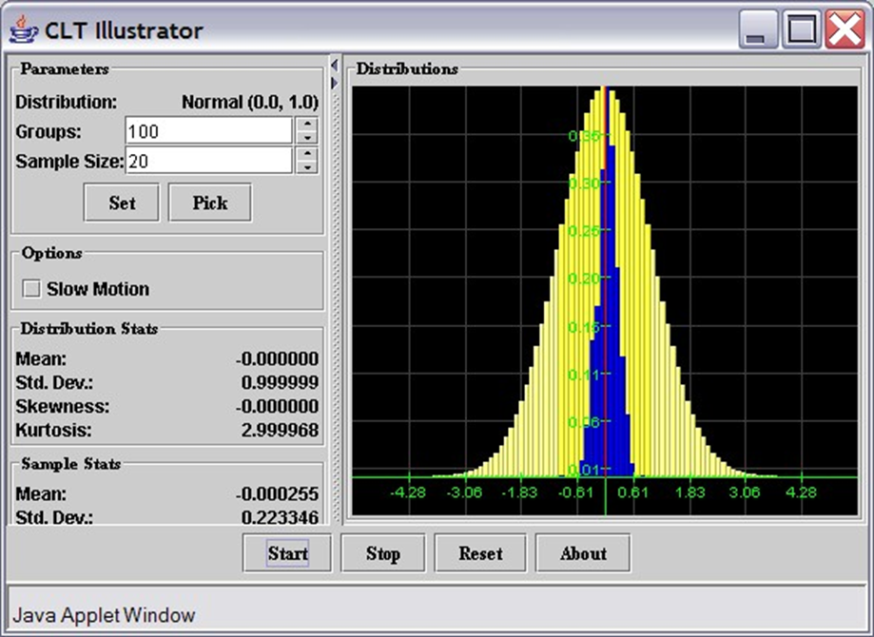
If you want to see the Central Limit Theorem in action, check out the Central Limit Applet (it requires that you have the Java Plug-in version 1.4 or better installed, which you could download here). Try the following:
  Click on the above link for the Central Limit Theorem applet
  You should see two buttons - click on the "Start CLT Applet" button (the page(s) might take a few minutes to initialize)

Slide 29
When you click "Start", the program will pick a random sample from a population, compute the mean, and mark where that mean is on the x-axis to start a frequency distribution for the sample mean. Then the program picks another random sample, computes its mean, marks it in blue, and continues in that fashion (you could check off the "Slow Motion" checkbox to see what the program does in slow motion"). After the program is running for a while, notice that the blue bars are slowing building up to a real frequency distribution (the yellow bars underneath show the distribution of the underlying population from which the random samples are selected. Now try the following:
  Let the program run (at regular speed) for a while. What shape is the distribution of the random samples (blue bars), at least approximately?
  Experiment with different distributions (click on [Pick] to choose another distribution). What shape does the distribution of the sample means (blue chart) have when you pick other distributions for the population? Is that true regardless of the underlying population distribution (yellow chart)?
  What is the mean for the distribution of the sample means (blue chart) in relation to the mean of the distribution of the original distribution (yellow chart)? The figures for the sample means are shown in the category "Sample Stats", but make sure to run the program for a while before looking at the numbers. Note that these numbers represent the "sample mean" for the distribution of all sample means, and the "sample standard deviation" for the distribution of all sample means (yes, it sounds odd, but that's what it is).
  Is there a relation between the standard deviation of the sample means (blue chart) and that of the original population (yellow chart)? Experiment with sample sizes 16, 25, 36, 49, and 64 to find the relation, but make sure to press the Reset button before using new parameters or sample sizes, and let the program run for a while before estimating the sample stats.

Slide 30
Confidence Intervals for Means
In chapter 4 we have seen how to compute the mean, median, standard deviation, and other descriptive statistics for a given data set, usually a sample from an underlying population. In this section we want to focus on estimating the mean of a population, given that we can compute the mean of a particular sample. In other words, if a sample of size, say, 100 is selected at random from some population, it is easy to compute the mean of that sample. It is equally easy to then use that sample mean as an estimate for the unknown population mean. But just because it's easy to do does not necessarily mean it's the right thing to do ...
For example, suppose we randomly selected 100 people, measured their height, and computed the average height for our sample to be, say, 164.432 cm. If we now wanted to know the average height of everyone in our population (say everyone in the US), it seems reasonably to say that the average height of everyone is 164.432 cm. However, if we think about it, it is of course highly unlikely that the average for the entire population comes out exactly the same as the average for our sample of just 100 people. It is much more likely that our sample mean of 164.432 cm is only approximately equal to the (unknown) population mean. It is the purpose of this chapter to clarify, using probabilities, what exactly we mean by "approximately equal". In other words:
Can we use a sample mean to estimate an (unknown) population mean, and - most importantly - how accurate is our estimated answer.

Slide 31
Example: Consider some data for approximately 400 cars. We assume that this data has been collected at random. We would like to make predictions about all automobiles, based on that random sample. In particular, the data set lists miles per gallon, engine size, and weight of 400 cars, but we would like to know the average miles per gallon, engine size, and weight of all cars, based on this sample.
It is of course simple to compute the mean of the various variables of the sample, using Excel. For our sample data we find that:
  mean gas mileage of the sample is 23.5 mpg with a standard deviation of 7.82 mpg, using 398 data values
But we need to know how well this sample mean predicts the actual and unknown population mean for the entire distribution. Our best guess is clearly that the average mpg for all cars is 23.5 mpg - it's after all pretty much the only number we have - but how good is that estimation?
In fact, we know more than just the sample mean. We also know that all sample means are distributed normally, according to the Central Limit Theorem, and that the distribution of all sample means (of which ours is just one) is normal with a mean of 23.5 mpg and a standard deviation of 7.82 / sqrt(398).

Slide 32
Using that information, let's make a quick d-tour into "mathematics land" - we will in a minute list a recipe for what we need to do, but for now, bear with me:
  Let's say we want to estimate an (unknown) population mean so that we are, say, 95% certain that the estimate is correct (or 90%, or 99%, or any other pre-determined notion of certainly we might have).
  To provide a reasonable estimate, we need to compute a lower number a and an upper number b in such a way as to be 95% sure that our (unknown) population mean is between a and b.

Slide 33
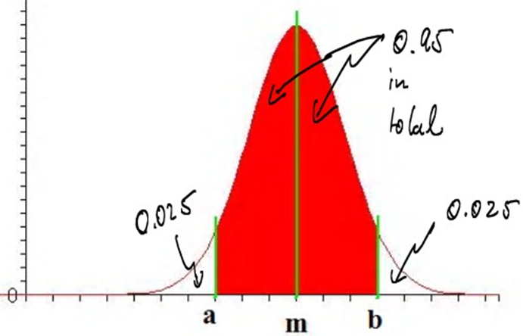
  That interval (a, b) is known as a 95% confidence interval for the unknown mean.
    Using standard probability notation we can rephrase this: we want to find a and b so that P(a < m < b) = 0.95, i.e. the probability that the (unknown) mean is between a and b should be 0.95, or 95%, which could be depicted as follows:

Slide 34
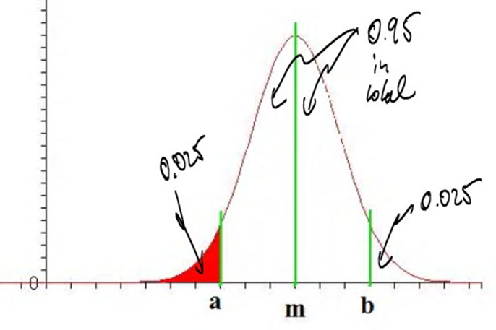
  Using symmetry and focusing on the part of my distribution that we can compute with Excel, this is equivalent to finding a value of a such that P(x < a) = 0.025, where x is normally distributed, as in the following picture:

Slide 35
If the distribution had mean 0 and standard deviation 1 we could use some trial-and-error in Excel to compute the desired number a - note that if we assume that the mean was 0, a should be negative. In other words, we use Excel to compute NORMDIST(a, 0, 1, TRUE), where we guess some values of a:
    NORMDIST(-0.5,0,1,TRUE) = 0.308537539 (too much probability)
    NORMDIST(-1.5,0,1,TRUE) = 0.066807201 (still too much)
    NORMDIST(-2.0,0,1,TRUE) = 0.022750132 (now it's too little)
    NORMDIST(-1.9,0,1,TRUE) = 0.02871656 (again, too much)
    NORMDIST(-1.95,0,1,TRUE) = 0.02558806 (a little too much)
    NORMDIST(-1.96,0,1,TRUE) = 0.024997895 (just about right)
Thus, if the mean was 0 and the standard deviation was 1, the number a = -1.96 would be just about right, and using symmetry we can conclude that b = +1.96. However, we don't know the mean and standard deviation of our population, so what can we do ... Central Limit Theorem to the rescue!

Slide 36
According to the Central Limit Theorem, the mean and standard deviation of the distribution of all sample means is m and s / sqrt(N), respectively, where m is the sample mean and s is the sample standard deviation. Thus, the mean we are supposed to use is the sample mean m and the standard deviation s / sqrt(N), according to the Central Limit Theorem. Putting everything together, we found that we have computed a 95% confidence interval as follows:
from m - 1.96 * s / sqrt(N) to m + 1.96 * s / sqrt(N)
Note: The term s / sqrt(N) is also known as the Standard Error
The above explanation is perhaps somewhat confusing, and there are some parts where I've glossed over some important details. But the resulting formulas are simple, and those formulas will be what we want to focus on. In addition to the number 1.96 that we have derived for a 95% confidence interval, other numbers can be derived in a similar way for the 90% and 99% confidence intervals:

Slide 37
Confidence Interval for Mean (large sample size N > 30)
Suppose you have a sample with N data points, which has a sample mean m and standard deviation s. Then:
  To compute a 90% confidence interval for the unknown population mean, compute the numbers:
  m - 1.645 * s / sqrt(N) and m + 1.645 * s / sqrt(N)
    Then there is a 90% probability that the unknown population mean is between these values.
  To compute a 95% confidence interval for the unknown population mean, compute the numbers:
  m - 1.96 * s / sqrt(N) and m + 1.96* s / sqrt(N)
    Then there is a 95% probability that the unknown population mean is between these values.
  To compute a 99% confidence interval for the unknown population mean, compute the numbers:
  m - 2.54 * s / sqrt(N) and m + 2.54 * s / sqrt(N)
    Then there is a 99% probability that the unknown population mean is between these values.
Using these formulas we can now estimate an unknown population mean with 90%, 95%, or 99% certainty. Other percentages are also possible, but these are the most frequently used ones.

Slide 38
Returning to our earlier example, where m = 23.5, s = 7.82, and N = 398 we have:
  90% confidence interval: from 23.5 - 1.645 * 7.82 / sqrt(398) = 22.85 to 23.5 + 1.645 * 7.82 / sqrt(398) = 24.14, thus:
  we are 90% certain that the average mpg for all cars is between 22.85 and 24.14
  95% confidence interval: from 23.5 - 1.96 * 7.82 / sqrt(398) = 22.73 to 23.5 + 1.96 * 7.82 / sqrt(398) = 24.27, thus:
  we are 95% certain that the average mpg for all cars is between 22.73 and 24.27
  99% confidence interval: from 23.5 - 2.54 * 7.82 / sqrt(398) = 22.5 to 23.5 + 2.54 * 7.82 / sqrt(398) = 24.4, thus:
  we are 99% certain that the average mpg for all cars is between 22.5 and 24.4
Note that a 99% confidence interval is larger - i.e. includes more numbers - than a 90% confidence interval. That makes sense, since if we want to be more certain, we must allow for more values. Ultimately, a 100% confidence interval would simply consist of all possible numbers, or in an interval from -infinity to +infinity . That would certainly be correct, but is not very useful for practical applications.

Slide 39
While the above calculations can easily be done with a calculator (or Excel), our favorite computer program Excel provides - yes, you might have guessed it - a quick shortcut to obtain confidence intervals. We will proceed as follows:
  Load the above data into Excel
  Select "Data Analysis..." from the "Data" ribbon and select "Descriptive Statistics"
  Select as input range the first few columns, including "Miles per Gallon", "Engine Size", "Horse Powers", and "Weight in Pounds".
Note that we actually are not interested in "Horse Powers" but the input data range must consist of consecutive cells so we might as well include "Horse Powers" but ignore it in the final output. We should check the "Labels in First Row" box as well as "Summary Statistics" and "Confidence Level for Mean: " in the "Output options" section. We need to enter a level of confidence for the "Confidence Level for Mean". Common numbers are 90%, 95%, or 99% - we will explain the differences below again, or see the discussion above.

Slide 40
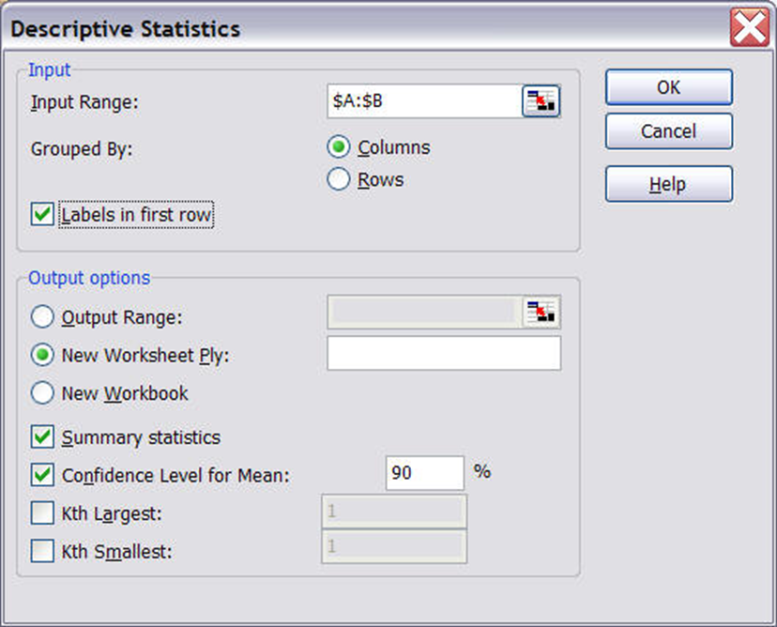
For now, make sure that the figures are as indicated above.

Slide 41
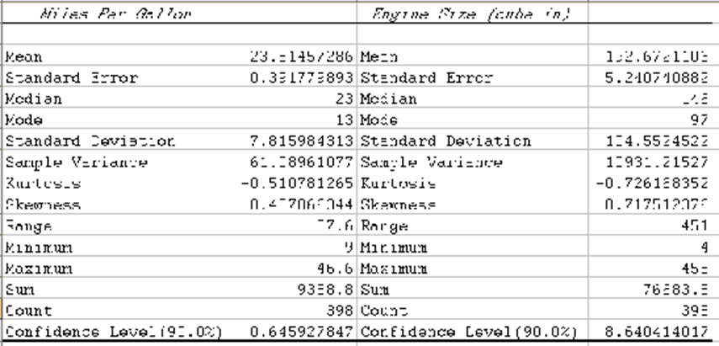
  Click on "OK" to see the following descriptive statistics (similar to what we have seen before):

Slide 42
What this means is that the sample mean of, say, "Mile per Gallon" is 23.5145. That sample mean may or may not be the same as the average MPG of all automobiles. But we have also computed a 90% confidence interval, which means, in this case, the following:
Under certain assumptions on the distribution of the population, we predict - based on our sample of 393 cars - that the average miles per gallon of all cars is somewhere between 23.5145 - 0.6459 = 22.87 and 23.5145 + 0.6459 = 24.16, and we are 90% certain that this answer is correct.
Please note that this 90% confidence interval is slightly different from the confidence interval we computed previously "by hand". That is no coincidence, because the derivation of the formulas for confidence intervals uses the Central Limit Theorem and that theorem, in effect, states that the distribution of the sample means is approximately normal. However, that approximation works best the larger N (the sample size) is. Excel uses a slightly different method to compute confidence intervals:
  If N is sufficiently large (30 or more) the "manual" method and Excel's method agree closely. In this case the method is based on the standard normal distribution
  If N is small (less than 30) the "manual" method is no longer appropriate and you should use Excel's method instead. In this case the method is based on the Student's T Distribution

Slide 43
Example: According to Excel, the average engine size in our sample of size N = 398 is 192.67 cubic inches, with a standard deviation of 104.55 cubic inches. Use these statistics to manually compute a 90% confidence interval. Then compare it with the figure Excel produces for the same interval.
To compute a 90% confidence interval manually:
  from m - 1.645 * s / sqrt(N) to m + 1.645 * s / sqrt(N)
  from 192.67 - 1.645 * 104.55 / sqrt(398) to 192.67 + 1.645 * 104.55 / sqrt(398)
  from 192.67 - 8.62 to 192.67 + 8.62
  from 184.05 to 201.29
To compute a 90% confidence interval using Excel
  as the above output shows, the mean m = 192.67 while the confidence level (90%) is 8.64
  from 192.67 - 8.64 to 192.67 + 8.64
  from 184.03 to 201.31
Thus, since the sample size is large (certainly larger than 30) the intervals computed manually and with Excel are virtually identical. For the picky reader, note that Excel's interval is slightly larger, so it's slightly more conservative than the manual computation, but the difference in this case is negligible.
Similarly, according to Excel the average weight in pounds of all cars is 2969.5161 - 69.5328 and 2969.5161 + 69.5328, and we are 90% certain that we are correct.

Slide 44
To recap: Instead of providing a point estimate for an unknown population mean (which would almost certainly be incorrect) we provide an interval instead, called confidence interval. Three particular confidence intervals are most common: a 90%, a 95%, or a 99% confidence interval. That means that:
  if the interval was computed according to a 90% confidence level, then the true population mean is between the two computed numbers with 90% certainty, and the probability that the true population mean is not inside that interval is less than 10%
  if the interval was computed according to a 95% confidence level, then the true population mean is between the two computed numbers with 95% certainty, and the probability that the true population mean is not inside that interval is less than 5%
  if the interval was computed according to a 99% confidence level, then the true population mean is between the two computed numbers with 99% certainty, and the probability that the true population mean is not inside that interval is less than 1%

Slide 45
Example: Suppose we compute, for the same sample data, both a 90% and a 99% confidence interval. Which one is larger ?
To answer this question, let's compute both a 90% and a 99% confidence interval for the "Horse Power" in the above data set about cars, using Excel. The procedure of computing the numbers is similar to the above; here are the answers:
  the sample mean for the "Horse Power" is 104.8325
  the 90% confidence level results in 3.1755, so that the 90% confidence interval goes from 104.8325 - 3.1755 to 104.8325 + 3.1755, or from 101.657 to 108.008
  the 99% confidence level results in 4.9851, so that the 99% confidence interval goes from 104.8325 - 4.9851 to 104.8325 + 4.9851, or from 99.84735 to 109.8176
That means, in general, that a 99% confidence interval is larger than a 90% confidence interval. That actually makes sense: if we want to be more sure that we have captured the true (unknown) population mean correctly, we need to make our interval larger. Hence, a 99% confidence interval must include more numbers than a 90% confidence interval; it is therefore wider than a 90% interval.

