Slide 1
Testing
By Dr. Justin Bateh, Florida State College at Jacksonville &
Dr. Bert Wachsmuth, Seton Hall University

Slide 2
Statistical Testing
In this chapter we will introduce hypothesis testing to enable us to answer questions such as the following:
  A company is labeling their product to weigh, on average 10 oz. However, the last time we bought that product it only weighed 8.5 oz so we suspect the company is cheating and puts less product in the package that it is putting on the label. We want to determine whether our suspicion is true or not.
  A new medical drug is supposed to work better in lowering a person's cholesterol level than currently existing drugs. From past experiments we know that the existing drugs lower cholesterol levels by 10 units, on average (I made up the numbers -:). We want to determine whether the new drug really is more effective than the existing ones.
In general: We are interested in testing a particular hypothesis and we want to decide whether it is true or not. Moreover, we want to associate a probability with our decision so that we know how certain (or uncertain) we are that our decision is correct.
We will approach this problem like a trial. Recall that in a standard trial in front of a judge or jury there are two mutually exclusive hypothesis:
    The defendant is either guilty or not guilty
During the trial evidence is collected and weighed either in favor of the defendant being guilty (the job of the DA) or in favor of the defendant being not guilty (the job of the Defense Lawyer). At the end of the trial the judge (or jury) decides between the two alternatives and either convicts the defendant (if he/she was assumed to be proven guilty beyond a reasonable doubt) or let them go (if there was sufficient doubt in the defendant's guilt).
Note that a defendant is "innocent until proven guilty". If the judge (or jury) decides a defendant is not guilty, that does not necessarily mean he/she is innocent. It simply means there was not enough evidence for a conviction.

Slide 3
In general, a statistical test involves four elements to a statistical test:
  Null Hypothesis (written as H₀): The "tried and true situation", or "the status quo", or "innocent until proven guilty"
  Alternative Hypothesis (written as H_{a}): This is what you suspect (or hope) is really true, the new situation, "guilty" - in general it is the opposite of the null hypothesis
  Test Statistics: Collecting evidence - in our case we usually select a random sample and compute some number based on the sample data
  Rejection Region: Do we reject the null hypothesis (and therefore accept the alternative), or do we declare our test inconclusive, and if we do decide to reject the null hypothesis, what is the probability that our decision is incorrect.
Please note that our final conclusion is always one of two options: we either reject the null hypothesis or we declare the test invalid. We never conclude anything else, such as accepting the null hypothesis.
  Rejecting the null hypothesis when in fact it is true is called a Type I - Error. That's exactly the error we will be computing in the procedure above when we reject the null hypothesis. It should, of course, be small so that we can be confident in our decision to reject the null hypothesis.
  Accepting the null hypothesis when in fact it is false is called a Type II - Error. This type of probability is not covered by our procedure (which is why we will never accept the null hypothesis, we rather declare our test inconclusive if necessary)

Slide 4
Example: A new antihypertensive drug is tested. It is supposed to lower blood pressure more than other drugs. Other drugs have been found to lower the pressure by 10 mmHg on average, so we suspect (or hope) that our drug will lower blood pressure by more than 10 mmHg. To collect evidence, we select a random sample of size n = 62 (say), which was found to have a sample mean of 11.3 and a sample standard deviation of 5.1. Is the new drug better than the old drugs, i.e. does the new drug lower blood pressure more than other drugs?
Since the sample mean is 11.3, which is more than other drugs, it looks like this sample mean supports the claim (because the mean from our sample is indeed bigger than 10). But - knowing that we can never be 100% certain - we must compute a probability and associate that with our conclusion, if indeed we want to make that conclusion.

Slide 5
In other words, we need to setup the four components of a statistical test: the population is the amount of decrease in blood pressure in people who have been given the new drug.
  The Null Hypothesis is the "tried and true" assumption that all drugs are about the same and the new drug has about the same effect as all other drugs. Thus, the null hypothesis is that the average decrease in blood pressure (the population mean) is 10 mmHg, just as for all other drugs.
  The Alternative Hypothesis is what we hope to be true, i.e. that the new drug results in higher decrease than the traditional dugs. Thus, the alternative hypothesis is that the average decrease in blood pressure (the population mean) is more than 10 mmHg.
  For our Test Statistics we collect evidence in form of our random sample. We found that for this random sample the sample mean is 11.3 mmHg, the sample standard deviation is 5.1 mmHg, and the sample size N is 62. These figures are converted into a single number (as described in the next chapter). In this case the test statistics will turn out to be
  z = 2.01
  Rejection Region: Finally we use the test statistics z = 2.01 to compute the probability p of committing an error in deciding that the null hypothesis is true (the type-1 error). If that error is small, we do indeed decide to reject the null hypothesis, otherwise we will declare the test to be invalid. In this case the probability will turn out to be (see next chapter):
  p = 2*P(z > 2.01) = 0.044 or 4.4%
So, if we decide to reject the null hypothesis, that decision is invalid with a probability of about 4% (or correct with a probability of 96%). That's good enough for us so we decide indeed to reject the null hypothesis. Since we reject the null hypothesis we automatically accept the alternative, and thus we think there is sufficient evidence that the new drug is better than the existing drugs in lowering blood pressure.
So, how do we compute the above numbers to arrive at this decision ... read the next section.

Slide 6
Statistical Test for Population Mean (Large Sample)
In this section will try to answer the following question: It has been known that some population mean is, say, 10, but we suspect that the population mean for a population that has "undergone some treatment" is different from 10, perhaps larger than 10. We want to determine whether our suspicion is true or not.
We will follow the outline of a statistical test as described in the previous section, but adjust the four elements of the test to our situation of testing for a population mean (we will see other tests in subsequent sections).
Example 1: A new antihypertensive drug is tested. It is supposed to lower blood pressure more than other drugs. Other drugs have been found to lower the pressure by 10 mmHg on average, so we suspect (or hope) that our drug will lower blood pressure by more than 10 mmHg.
At this stage we can setup the two competing hypothesis:
  Null Hypothesis H₀: population mean = 10.0
  Alt. Hypothesis H_{a}: population mean not equal to 10.0
We would like to know whether the new drug shows results different from the other drugs, in particular whether it is better than the old drugs, i.e. does the new drug lower blood pressure more than other drugs? To collect evidence, we select a random sample of size n = 62 (say), which was found to have a sample mean of 11.3 and a sample standard deviation of 5.1.

Slide 7
Since the sample mean is 11.3, which is more than other drugs, it looks like this sample mean supports our suspicion (because the mean from our sample is indeed bigger than 10). But - knowing that we can never be 100% certain - we must compute a probability and associate that with our conclusion.
Assuming that the null hypothesis is true we will try to compute the probability that a particular sample mean (such as the one we collected) could indeed occur. Leaving the details of the computation aside for now, it turns out that the associated probability
p = 0.044
But if that computation is correct (which it is -:) we have a problem: assuming that the null hypothesis is true, the probability of observing a random sample mean of 11.3 or more is quite small (less than 5%). But we have observed a sample mean of 11.3, there no denying that fact. So, something is not right: either we were extremely lucky to have hit the less than 5% case, or something else is wrong: our assumption that the null hypothesis was true. Since we don't believe in luck, we choose to reject the null hypothesis (even though there's a 4.4% chance - based on our evidence - that the null hypothesis could still be right).
The only practical consideration is: how do we compute the probability p?
We want to know the chance that a sample mean could be 11.3 (or more), given that we assume the population mean to be 10.0 (our null hypothesis). In other words, we want to compute:
P(sample mean > 11.3) = ... we could do that if we only knew the distribution to use (see chapter 7.1)

Slide 8
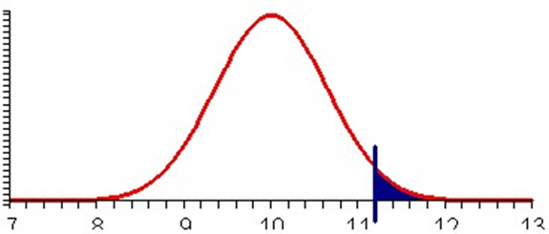
But from chapter 7.2 (Central Limit Theorem) we do know the distribution of sample means: according to that theorem we know that the mean of the sample means is the same as the population mean, and the standard deviation is the original standard deviation divided by the square root of N (the sample size). In other words, if the original mean is m and the original standard deviation is s, then the distribution of the sample means are N(m, s / sqrt(n) ). And since we assumed the null hypothesis was true, we actually know (as per assumption) the population mean, and - since nothing else is available, we use the standard deviation as computed from the sample to figure as the standard deviation we need. Therefore, we know that, in our case:
          mean to use: 10.0
          standard deviation to use: 5.1/sqrt(62)
But now Excel can, of course, help perfectly fine: it provides the function called "NORMDIST" to compute probabilities such as this one. Therefore, using the Central Limit Theorem:
P(sample mean > 11.3) = 1 - NORMDIST(11.3, 10.0, 5.1/sqrt(62), TRUE) = 0.022

Slide 9
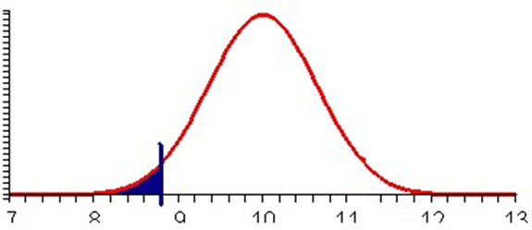
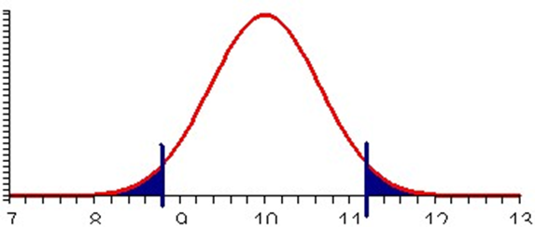
But we are not yet done: right now we only took into account that the sample mean could be 11.3 = 10 + 1.3 or more, whereas our alternative was that the mean is not equal to 10.0. Therefore we should also take into account that the probability could be smaller than 10 - 1.3 = 8.7. Again, Excel let's us compute this easily:
  P(sample mean < 8.7) = NORMDIST(8.7, 10.0, 5.1/sqrt(62), TRUE) = 0.022
Finally, since the alternative hypothesis is not equal to 10.0 we need to consider both probabilities together. In other words, the value of p we need is, using symmetry of the normal distribution:
  p = P(sample mean < 8.7) + P(sample mean > 11.3) = 2 * (1 - NORMDIST(11.3, 10.0, 5.1/sqrt(62), TRUE)) = 0.044

Slide 10
In chapter 7.1 we learned how to use the NORMDIST function to compute probabilities such as the ones we are interested in, but NORMDIST is somewhat difficult to use (we have to enter all these parameters at the right place). To simplify our calculation, we will instead use the new Excel function
        NORMSDIST(z) (notice the "S" in the middle of that function name)
which gives the probability using a standard normal distribution (mean 0, standard deviation 1), instead of the usual NORMDIST(x, m, s, TRUE) function. It is simpler to use because it requires only one input value. Both functions are related as follows:
        NORMSDIST( (x - m) / (s / sqrt(n)) ) = NORMDIST(x, m, s / sqrt(s), TRUE)

Slide 11
Therefore, to compute probabilities we now proceed in two steps:
  Step 1: compute the so-called z-score z = (x - m) / ( s / sqrt(n)) (notice the extra set of parenthesis around numerator and denominator)
  Step 2: compute the probability using NORMSDIST(z) instead of NORMDIST(x, m, s/sqrt(n), TRUE)
In the above case we have:
  z = (11.3 - 10) / (5.1 / sqrt(62)) = 1.71, or in Excel, use:
  = (11.3 - 10) / (5.1 / sqrt(62))
  p = 2 * (1 - NORMSDIST(2.01)) = 0.44, or in Excel use:
  = 2 * (1 - NORMSDIST(2.01)
In other words, instead of entering the original mean, standard deviation, and sample size into the NORMDIST function wefirst compute a z-score, and then we use the NORMSDIST function to compute a probability.
Now we are ready to summarize our example into a procedure for testing for a sample mean as follows. The good news is that even if the above derivation seems complicated and perhaps confusing, the procedure we will now summarize is relatively simple and straight-forward. It works fine even if you did not understand the above calculations, as the subsequent examples will illustrate.

Slide 12
Statistical Test for the Mean (large sample size N > 30):
Fix an error level you are comfortable with (something like 10%, 5%, or 1% is most common). Denote that "comfortable error level" by the letter "A" If no prescribed comfort level A is given, use 0.05 as a default value. Then setup the test as follows:
  Null Hypothesis H₀:
  mean = M, i.e. The mean is a known number M
  Alternative Hypothesis H_{a}:
  mean ≠ M, i.e. mean is different from M (2-tail test)
  Test Statistics:
    Select a random sample of size N, compute its sample mean X and the standard deviation S. Then compute the corresponding z-score as follows:
  Z = (X - M) / ( S / sqrt(N) )
  Rejection Region (Conclusion)
  Compute p = 2*P(z > |Z|) = 2 * (1 - NORMSDIST(ABS(Z)))
If the probability p computed in the above step is less than A (the error level you were comfortable with initially, you reject the null hypothesis H₀ and accept the alternative hypothesis. Otherwise you declare your test inconclusive.

Slide 13
Comments
The null hypothesis, for this test, is that the population mean is always equal to a particular number. That number is usually thought of as the "default value", or the "status quo", or the "best guess" value. It is usually mentioned somewhere in the problem.
The alternative hypothesis could actually be split into 3 possibilities (mean less than M, mean greater than M, or mean not equal to M). However, for simplicity we will restrict ourselves to the more conservative case where mean is not equal to M. Note that this is called a "2-tailed" test, while "mean < M" or "mean > M" would be called "1-tailed" test - we only consider 2-tailed tests.
After computing the z-score in the third step you use the NORMSDIST function, not the NORMDIST function, to compute your probability in the last step. Note that the ABS function mentioned in the above recipe stands for "absolute value".
Your conclusion is always one of two options: you either reject the null hypothesis or declare your test invalid. Younever conclude anything else, such as accepting the null hypothesis. If the comfort level A is not given in a particular problem, use 5%, or A = 0.05.

Slide 14
Technically speaking, this particular test works under the following assumptions:
  The standard deviations of the sample and the population are the same and are known
  The sample size is 30 or more
The probability computed in part 3 of our test and used to determine the rejection region gives the Level of Significance of the test. The smaller it is, the more likely you are to be correct in rejecting the null hypothesis. Recall that there are two types of error that you could commit:
  Reject the null hypothesis when in fact it is true (Type I - Error). That's exactly the error we are computing in the procedure above as "level of significance".
  Accept the null hypothesis when in fact it is false (Type II - Error). This type of probability is not covered by our procedure (which is why we never accept the null hypothesis, we rather declare our test inconclusive if necessary
Please note that even if we reject a null hypothesis (and hence accept the alternative) it is still possible that the null hypothesis is true after all. However, the probability with which that can happen is p, which is small if we choose this answer (smaller than our pre-determined comfort level A).

Slide 15
Example 2: Bottles of ketchup are filled automatically by a machine which must be adjusted periodically to increase or decrease the average content per bottle. Each bottle is supposed to contain 18 oz. It is important to detect an average content significantly above or below 18 oz so that the machine can be adjust:; too much ketchup per bottle would be unprofitable, while too little would be a poor business practice and open the company up to law suites about invalid labeling.
We select a random sample of 32 bottles filled by the machine and compute their average weight to be 18.34 with a standard deviation of 0.7334. Should we adjust the machine? Use a comfort level of 5%.
We can see right away that the average weight of our sample, being 18.34 oz, is indeed different from what it's supposed to be (18 oz), but the question is whether the difference is statistically significant. In our particular case we want to know whether the machine is "off" and be sure to allow at most a 5% chance of an error in our conclusion. After all, if we did conclude the difference is significant we would have to adjust the Ketchup machine, which is an expensive procedure that we don't want to perform unnecessarily.

Slide 16
Our statistical test for the mean will provide the answer:
  The Null Hypothesis is: the mean is equal to 18, i.e. "everything is fine"
  The Alternative Hypothesis is: mean is not equal to 18 (2-tail test), i.e. we should adjust the machine
  The Test Statistics: sample mean is 18.34, standard deviation is 0.7334, sample size is 32. Compute the z-score as follows
  Z = (18.34 - 18) / (0.7334 / sqrt(32)) = 2.622
  We use Excel to compute p = 2*(1-NORMSDIST(2.622)) = 0.0087, according to case (c) of our procedure. That probability is smaller than our comfort level A = 0.05 (or 5%) so that we reject the null hypothesis
In other words, we conclude that the difference was statistically significant and that therefore the alternative hypothesis is (likely) true. Therefore, we will adjust the ketchup filling machine. Note that while we feel comfortable rejecting the null hypothesis (and adjusting the machine) the probability that this decision (and our course of action) is incorrect is 0.8%.

Slide 17
Example 3: In a nutrition study, 48 calves were fed "factor X" exclusively for six weeks. The weight gain was recorded for each calf, yielding a sample mean of 22.4 pounds and a standard deviation of 11.5 pounds. Other nutritional supplements are known to cause an average weight gain of about 20 lbs in six weeks. Can we conclude from this evidence that, in general, a six-week diet of "factor X" will yield an average weight gain of 20 pounds or more at the "1% level of significance"? In other words, is "factor X" significantly better than standard supplements?
  The Null Hypothesis is: the mean is equal to 20, i.e. there is no improvement, everything is as it's always been
  The Alternative Hypothesis is: the mean is not equal 20 (we actually want to know whether "factor X" results in higher average weight gains, which would be a 1-tail test but for simplicity we change the alt. hypothesis to check simply for a difference in weight gain)
  Test statistics: sample mean is 22.4, standard deviation is 11.5, sample size is 48. Compute the z-score
  Z= (22.4 - 20) / (11.5 / sqrt(48) ) = 1.446
  We use Excel to compute p = 2*(1 - NORMSDIST(1.446)) = 0.148, or 14.8%. This probability is relatively large: if we rejected the null hypothesis, the probability that we made a mistake is 14.8%. That is larger than our comfort level of 1%, so our conclusion is: the test is inconclusive
Our test, being inconclusive, is not really satisfying: all our work was for nothing, we are unwilling to give a definite answer. In particular, while we are not ready to reject the null hypothesis, we are also not accepting it - we simply say there's insufficient evidence. This is similar to a standard trial in front of a judge or jury: some being found not guilty does not necessarily mean he/she is really innocent. It just means there was insufficient evidence for a conviction.

Slide 18
Example 4: A group of secondary education student teachers were given 2 1/2 days of training in interpersonal communication group work. The effect of such a training session on the dogmatic nature of the student teachers was measured y the difference of scores on the "Rokeach Dogmatism test given before and after the training session. The difference "post minus pre score" was recorded as follows:
-16, -5, 4, 19, -40, -16, -29, 15, -2, 0, 5, -23, -3, 16, -8, 9, -14, -33, -64, -33
Can we conclude from this evidence that the training session makes student teachers less dogmatic (at the 5% level of significance) ?

Slide 19
We can easily compute (using Excel) that the sample mean is -10.9 and the standard deviation is 21.33. The sample size N = 20. Our hypothesis testing procedure is as follows:
  Null Hypothesis: there is no difference in dogmatism, i.e. mean = 0
  Alternative Hypothesis: there is a difference in dogmatism, i.e. mean not equal to 0 (note that we again switched from a 1-tail test - dogmatism actually goes down - to a 2-tail test - dogmatism is different, for simplicity).
  Test statistics: sample mean = -10.9, standard deviation = 21.33, sample size = 20. Compute the z score:
  z = (-10.9 - 0) / (21.33 / sqrt(20) ) = -2.28
  We use Excel to compute p = 2*(1 - NORMSDIST(2.28)) = 0.022, or 2.2%. That probability is less than 0.05 so we reject the null hypothesis
Thus, since we reject the null hypothesis we accept the alternative, or in other words we do believe that the training session makes the student teachers differently dogmatic, and since the mean did go down, less dogmatic. The probability that this is incorrect is less than 5% (or about 2.2% to be precise). For curious minds: for the 1-tail test p would have worked out to be p = 1.1% (half the 2-tail value) which would also have led to a rejection of the null hypothesis at the 5% level.
Please note that technically we were not supposed to use our procedure, since the sample size N = 20 is less than 30. Therefore, while we can still reject the null hypothesis, the true error in making that statement is somewhat larger than 2.2%. So, you ask: "what are we supposed to do for small sample sizes N < 30"? Funny you should ask - there's always another section ...

Slide 20
Statistical Test for Population Mean (Small Sample)
In this section will adjust our statistical test for the population mean to apply to small sample situations. Fortunately (sic!), this will be easy (in fact, once you understand one statistical test, additional tests are easy since they all follow a similar procedure.
The only difference in performing a "small sample" statistical test for the mean as opposed to a "large sample test" is that we do not use the normal distribution as prescribed by the Central Limit theorem, but instead a more conservative distribution called the T-Distribution. The Central Limit theorem applies best when sample sizes are large so that we need to make some adjustment in computing probabilities for small sample sizes. The appropriate function in Excel is the TDIST function, defined as follows:
TDIST(T, N-1, TAILS), where
    Tis the value for which we want to compute the probability
    N is the sample size (and N-1 is frequently called the "degrees of freedom")
    TAILS is either 1 (for a 1-tail test) or 2 (for a 2-tail test). Since we again consider 2-tailed tests only we always use 2

Slide 21
With that new Excel function our test procedure for a sample mean, small sample size, is as follows:
Statistical Test for the Mean (small sample size N < 30):
Fix an error level you are comfortable with (something like 10%, 5%, or 1% is most common). Denote that "comfortable error level" by the letter "A". Then setup the test as follows:
  Null Hypothesis H₀:
  mean = M, i.e. The mean is a known number M
  Alternative Hypothesis H_{a}:
  mean ≠ M, i.e. mean is different from M (2-tailed test)
  Test Statistics:
  Select a random sample of size N, compute its sample mean X and the standard deviation S. Then compute the corresponding t-score as follows:
  T= (X - M) / ( S / sqrt(N) )
  Rejection Region (Conclusion)
  Compute p = 2*(1 - P(t > |T|)) = TDIST(ABS(T), N-1, 2)
If the probability p computed in the above step is less than A (the error level you were comfortable with initially, you reject the null hypothesis H₀ and accept the alternative hypothesis. Otherwise you declare your test inconclusive.

Slide 22
Comments
The null and alternative hypothesis for this test are the same as before
The calculation of the test statistics is the same as before, but the result is called T instead of Z (oh well -:)
The TDIST function is similar to the NORMSDIST function, but it does not work for negative values of T (a limitation of Excel), and it automatically gives a "tail" probability. Thus, the computation of the p-value had to be adjusted accordingly.
The ABS function in the above formulas stands for the "absolute value" function. (In other words, just drop any minus signs ...

Slide 23
Example 1: A group of secondary education student teachers were given 2 1/2 days of training in interpersonal communication group work. The effect of such a training session on the dogmatic nature of the student teachers was measured y the difference of scores on the "Rokeach Dogmatism test given before and after the training session. The difference "post minus pre score" was recorded as follows:
-16, -5, 4, 19, -40, -16, -29, 15, -2, 0, 5, -23, -3, 16, -8, 9, -14, -33, -64, -33
Can we conclude from this evidence that the training session makes student teachers less dogmatic (at the 5% level of significance) ?
This is of course the same example as before, where we incorrectly used the normal distribution to compute the probability in the last step. This time, we will do it correctly, which is fortunately almost identical to the previous case (except that we use TDIST instead of NORMDIST):
  Null Hypothesis: there is no difference in dogmatism, i.e. mean = 0
  Alternative Hypothesis: dogmatism is different, i.e. mean not equal to 0
  Test statistics: sample mean = -10.9, standard deviation = 21.33, sample size = 20. Compute: T = (-10.9 - 0) / (21.33 / sqrt(20) ) = -2.28
  Rejection Region: We use Excel to compute p = TDIST(2.28, 19, 2) = 0.034, or 3.4%. That probability is less than 0.05 so we reject the null hypothesis.
Note that in the previous section we (incorrectly) computed the probability p to be 2.2%, now it is 3.4%. The difference is small, but can be significant in special situations. Thus, to be safe:
  if N > 30 use the Z-Test based on the standard normal distribution NORMSDIST as in the previous section
  if N < 30 use the T-Test based on the T-Distribution TDIST as in this section

Slide 24
Example 2: Suppose GAP, the clothing store, wants to introduce their line of clothing for women to another country. But their clothing sizes are based on the assumption that the average size of a woman is 162 cm. To determine whether they can simply ship the clothes to the new country they select 5 women at random in the target country and determine their heights as follows:
149, 165, 150, 158, 153
Should they adjust their line of clothing or they ship them without change? Make sure to decide at the 0.05-level.
By now statistical testing is second-nature.
  Null Hypothesis: mean height in new country is the same as in old country, i.e. M = 162
  Alt. Hypothesis: mean height in new country is different from old country, i..e. M not equal to 162 (either too small or too tall would be bad for GAP)
  Test Statistics: we can compute the sample mean = 155 and the sample standard deviation = 6.59 while the sample size is clearly N = 5. Therefore T = (155 - 162) / ( 6.59 / sqrt(5) ) = -2.37
  Rejection Region: We use Excel to compute p = TDIST(2.37, 4, 2) = 0.077. Thus, if we did decide to reject the null hypothesis the probability of that decision being wrong is 7.7%. That is larger than 0.05, thus we declare the test inconclusive.

Slide 25
Note that our test is inconclusive, which does not mean that we accept the null hypothesis. Thus, we don't recommend anything to GAP (since our test came out inconclusive). Using common sense, however, we recommend to GAP to conduct a new study but this time select a random sample of (much) larger size, something like 100 or more. Hopefully the new study will provide statistically significant evidence.
If you compare the T values in example 1 and 2 you see that they are very similar. Yet, the associated probabilities are very different. That is due to the fact that in example 1 we used a 1-tail test with a relatively high degree of freedom while in example 2 we had a 2-tail test with a very small degree of freedom. Both factors make the probabilities so different.

Slide 26
Two-Sample Difference of Means Test
Our last test applies to differences of means. Such tests are very common when you conduct a study involving two groups. In many medical trials, for example, subjects are randomly divided into two groups. One group receives a new drug, the second receives a placebo (sugar pill). Then the researcher measures any differences between the two groups.
Fortunately, we know how to do Hypothesis testing, and in this case we will exclusively use Excel to perform the calculations for us. Here is the setup for this test:
  Null Hypothesis: two means M₁ and M₂ differ by a fixed amount c, i.e. M₁ - M₂ = c
  Alternative Hypothesis: the two means M₁ and M₂ do not differ by the amount c, i.e. M₁ - M₂ not equal to c (2-tail)
  Test Statistics: as computed by Excel
  Rejection Region: probability as computed by Excel

Slide 27
Example 1: Two procedures to determine the amylase in human body fluids were studied. The "original" method is considered to be an acceptable standard method, while the "new" method uses a smaller volume of water, making it more convenient as well as more economical. It is claimed that the amylase values obtained by the new method average at least 10 units greater than the corresponding values from the original method. A test using the original method was conducted on 14 subjects, the test with the new method on 15 subjects, giving the data displayed in the table below. Test the claim at the 1% level.
Original | New
38 | 46
48 | 57
58 | 73
53 | 60
75 | 86
58 | 67
59 | 65
46 | 58
69 | 85
59 | 74
81 | 96
44 | 55
56 | 71
50 | 63
 | 74
We need to be careful as to which variable is the first and which is the second one. In our example we want to test whether the average for the new method is 10 units larger than the old average. Since our procedure always tests M₁ - M₂ we have to pick as M₁ the "new method" data and as M₂ the "original method" data. With those choices for M₁ and M₂ the statistical test corresponding to our example is setup as follows:
  Null Hypothesis: M₁ - M₂ = 10
  Alternative Hypothesis: M₁ - M₂ not equal to 10

Slide 28
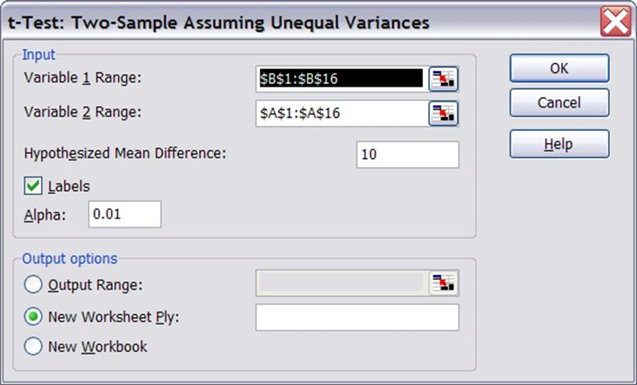
To continue, start Excel and enter the above data. Note that you do not really need to enter the first column, only the data for the original and new method is relevant.
Select Tools | Data Analysis ... then select t-Test: Two Sample, Assuming Unequal Variance
There are several two-sample tests available, for specific situations. A t-test assuming unequal variance is the most general one so select that. You should see a dialog window similar to the following:
Since we picked the "new method" data as variable 1 we need to put the data for the second column in the "variable 1" range and the first column data in the "variable 2" range:
  In the Variable 1 Range: enter the range for the data from the "New" method (column B)
  In the Variable 2 Range: enter the range for the data from the "Original" method (column A)
  In the Hypothesized Mean Difference: enter the number 10
  For the Alpha value: enter the number 0.01
  Make sure to check the Labels box and click on Okay.

Slide 29
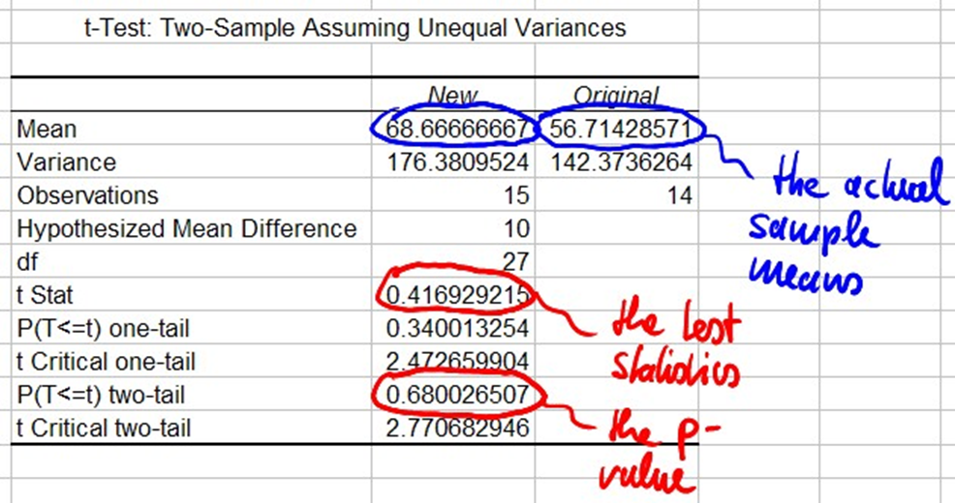
Excel will produce output similar to the following:
This output computes the mean and standard deviations of both variables, but most importantly computes the numbers needed to complete our test:
  Test Statistics: as computed by Excel, t = 0.4169
  Rejection Region: probability as computed by Excel: p = 0.68 (2-tail)
Thus, since the probability of the type-1 error is 0.68, or 68%, which is pretty large (definitely larger than 1%), our conclusion that the test is inconclusive. In other words, we found no significant evidence that the average of the new and old method differ by 10.

Slide 30
Comments
Excel requires that the hypothesized difference is not negative. If you want to test for a negative difference, switch the variables around and the difference will be positive.
The actual difference, for this data, is 68.66 - 56.71 = 11.95. That difference is different from 10, but not significantly different, according to our test.

Slide 31
Example 2: Using the above data, is there enough evidence at the 0.05-level to conclude that there is a difference between the new and old method ?
To test whether there is a difference we simply set the hypothesized difference to 0 (in which case it actually does not matter which variable is the first and which the second). Therefore we repeat the above test, but this time we enter 0 as hypothesized difference instead of 10 and 0.05 as our Alpha level. Excel will produce the following values as output (make sure to check it yourself):
  Null Hypothesis: M₁ - M₂ = 0
  Alternative Hypothesis: M₁ - M₂ not equal to 0
  Test Statistics: as computed by Excel, t = 2.55242
  Rejection Region: probability as computed by Excel: p = 0.016668 (2-tail)
In this case the computed probability is 0.017, or 1.7%, which is smaller than our value of A = 0.05. Therefore, we reject the null hypothesis which means that there is a significant difference between the two variables - it is just not as pronounced as we tested originally.

Slide 32
Example 3: The data file employeenumeric-split.xls contains the salaries for the Acme Widget Company, separated by sex. Use that data to test the hypothesis that women make at least $10,000 less on average than men.
First we determine which salary should be variable 1 and which variable 2:
if women are variable 1 and men are variable 2, then women making $10,000 less than men means M₁ - M₂ = -10000
if men are variable 1 and women are variable 2, then women making $10,000 less than men means M₁ - M₂ = 10000

Slide 33
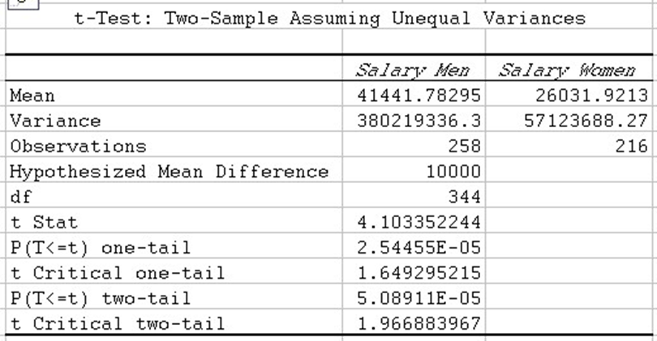
Since Excel's t-Test only works for non-negative hypothesized difference we have to select option 2. With that convention Excel will produce the following output (make sure to double-check it):
  Null Hypothesis: M₁ - M₂ = 10000
  Alternative Hypothesis: M₁ - M₂ not equal to 10000
  Test Statistics: as computed by Excel, t = 4.10335
  Rejection Region: probability as computed by Excel: p = 5.089E-05 (2-tail)
Since 5.089E-05 means 0.00005089 , the computed probability definitely warrants our rejection of the null hypothesis. Thus, the difference in average salary between men and women at the Acme Widget Company is at least $10,000. Note that our test actually confirms that the difference is not equal to $10,000, but looking at the actual values of the means as computed by Excel we can clearly conclude that the difference must be more than $10,000 (it is certainly not less).

